Slide 1
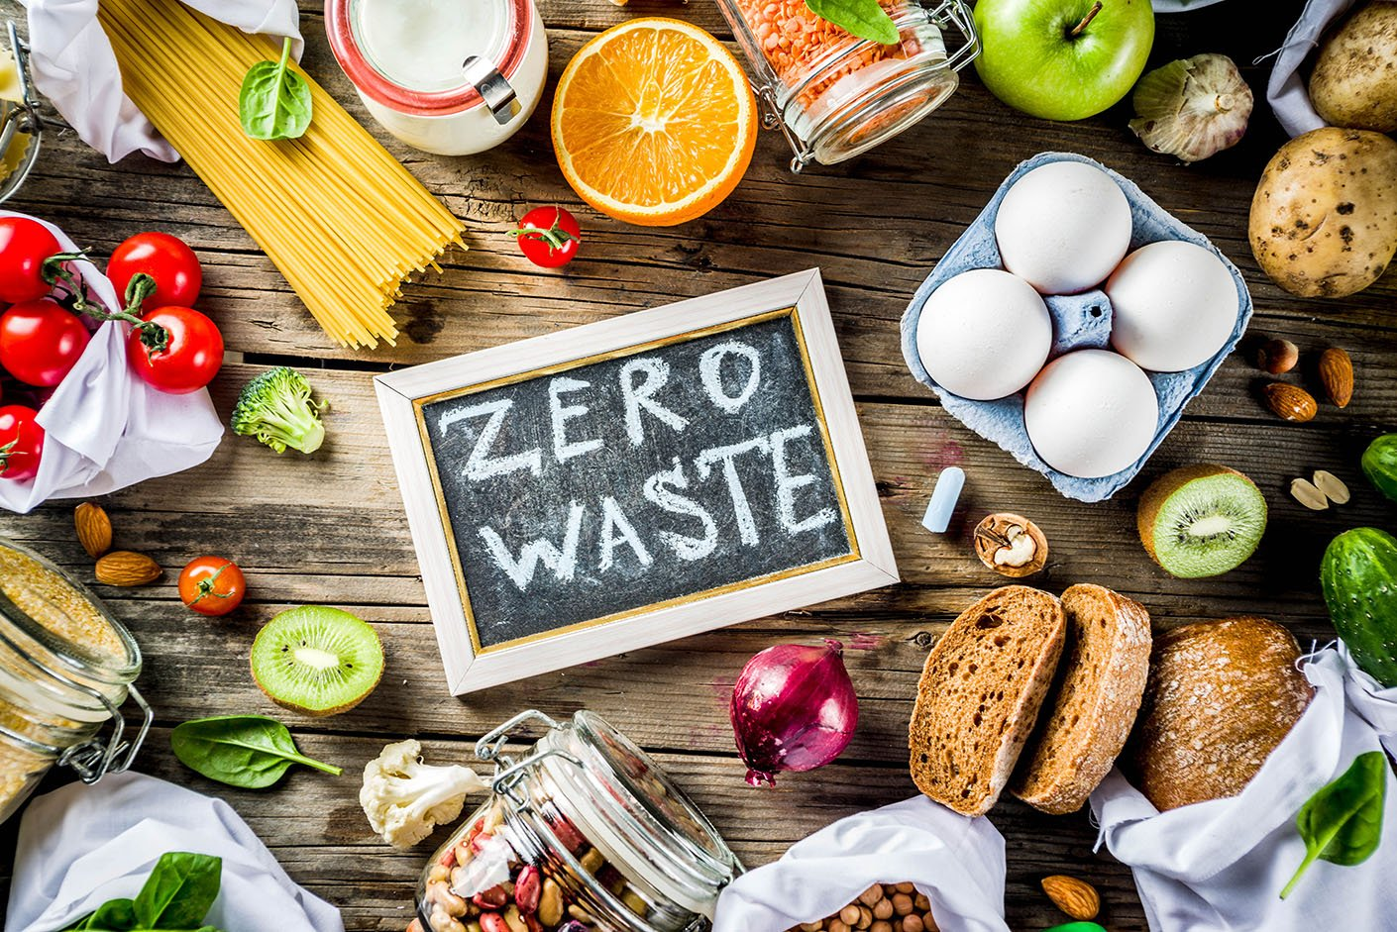
FOOD WASTE MANAGEMENT
------------------------------------------------------------------------------------------------------

Slide 2
INDEX
Overview:
Introduction to food waste and its impact.
Causes of Food Waste:
Factors contributing to food waste in households, businesses, and supply chains

Slide 3
INDEX
Reduction Strategies:
Methods for reducing food waste at home, in restaurants, supermarkets, and during production and distribution.
Effects of Food Waste:
Environmental, economic, and social impacts of food waste.

Slide 4
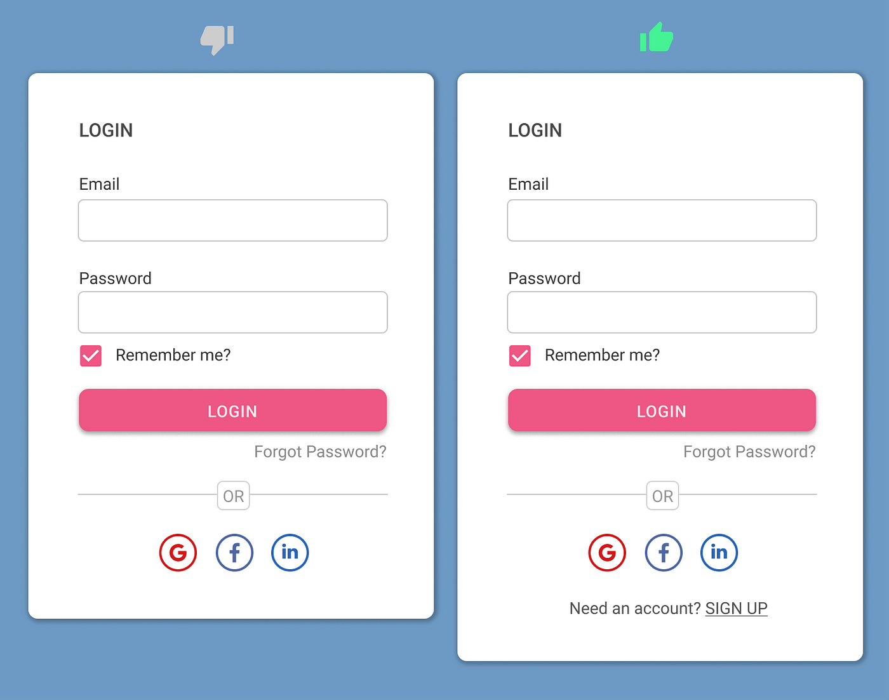
LOGIN

Slide 5
PROFILE
Creating a profile for food waste management involves detailing strategies to reduce waste, such as implementing composting programs, educating on proper storage and meal planning, and collaborating with businesses to donate surplus food to those in need. Additionally, it involves utilizing technology for smart inventory management and advocating for policy changes to minimize food waste on a larger scale.

Slide 6

ABOUT
Food waste management involves practices and strategies aimed at reducing, diverting, or repurposing food waste to minimize its environmental impact. It includes efforts such as reducing food waste at the source (e.g., through better planning and storage), redistributing surplus food to those in need, composting organic waste, and using technology to track and manage food inventory more efficiently. Proper management of food waste is crucial for reducing greenhouse gas emissions, conserving resources, and addressing global hunger.

Slide 7

CONTACT
Finding local contacts for food waste management can vary based on your location. Typically, you can reach out to waste management companies, local government agencies responsible for waste disposal and recycling, or organizations that specialize in food rescue, composting, or sustainable food initiatives. Additionally, food banks, community organizations, and NGOs often engage in food waste reduction efforts and might be good contacts or sources of information in your area. Would you like me to help you find specific contacts based on your location?

Slide 8
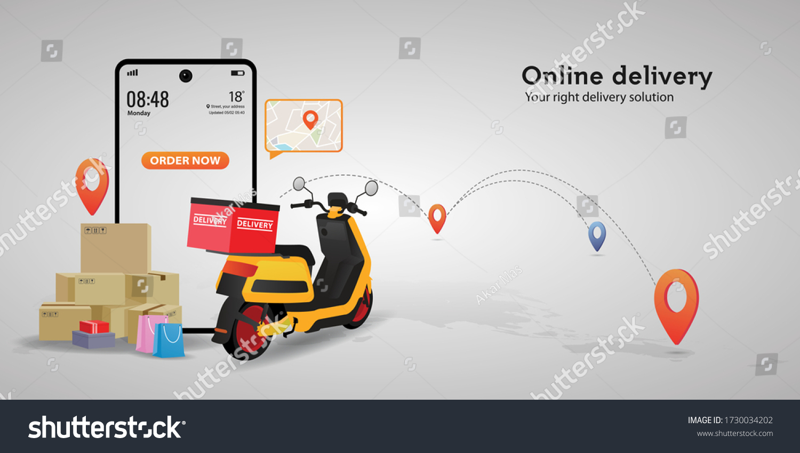
DELIVERY
Delivery for food waste management can encompass various services, such as waste collection, composting, or redistribution of surplus food. Waste management companies often offer pickup services for organic waste to be composted or processed at specialized facilities. Some companies also focus on redistributing excess food to charities or organizations that serve communities in need. Identifying local waste management or food rescue organizations in your area can provide options for delivery services related to food waste management. If you have a specific type of service or location in mind, I can assist you further with finding delivery options for food waste management.

Slide 9
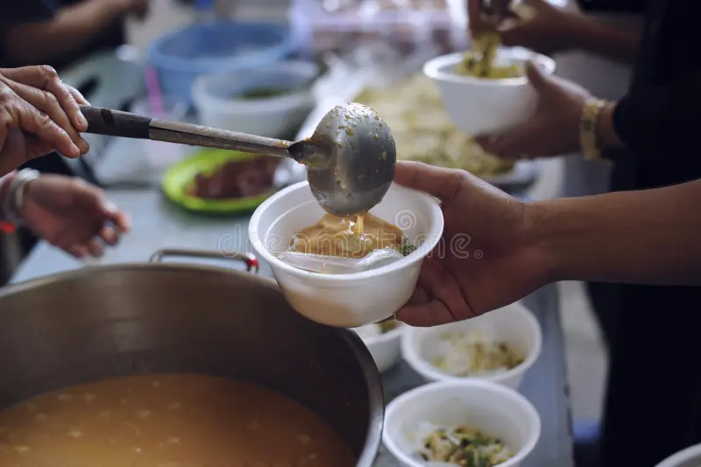
FOOD DONATE
Donating food is a critical aspect of food waste management. Many organizations and food banks accept surplus food donations from restaurants, supermarkets, and individuals to redistribute to those in need. Local charities, shelters, and food rescue groups often facilitate the collection and distribution of donated food items.

Slide 10
HOME
Managing food waste at home involves several practices to reduce, reuse, or recycle food scraps. You can start by minimizing waste through meal planning, proper storage to prolong freshness, and using leftovers creatively. Composting is an excellent way to manage organic waste; you can compost fruit and vegetable scraps, eggshells, coffee grounds, and more to create nutrient-rich soil for gardening. Additionally, some communities have programs for curbside organic waste collection or composting bins.
Investing in food storage containers, reusable bags, and being mindful of portion sizes can also significantly reduce household food waste. Additionally, consider donating surplus non-perishable items to local food banks or charities. These small actions collectively contribute to effective food waste management at home.

Slide 11
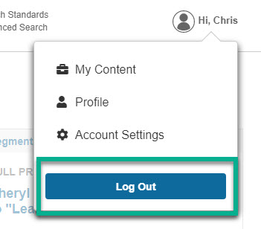
LOGOUT

Slide 12


